Slide 1
Gate Pass Digitalization

Slide 2
404 coders
Sahaja
Sowmya
Paras
Asrar
Akshay

Slide 3
About The Website
It is a website which puts up a request to respective HOD for gate pass with adequate information of the request. If approved is to be automatically sent to security staff near gate with details of the student

Slide 4
Technologies Used
PHP
MySQL
HTML
ZAMP

Slide 5
HTML
We used HTML to create the User-Interface for our website.
Hypertext Markup Language is the standard markup language for documents designed to be displayed in a web browser. It can be assisted by technologies such as Cascading Style Sheets and scripting languages such as JavaScript.

Slide 6
MySQL
We used MySQL to create and manipulate various databases required for our website.
MySQL is an open-source relational database management system. MySQL is one of the best RDBMS being used for developing various web-based software applications.

Slide 7
PHP
We used PHP as a bridge between the front-end and back-end i.e. to link database to the U.I .
Hypertext Preprocessor(or simply PHP) is a general purpose programming language originally designed for web development.

Slide 8
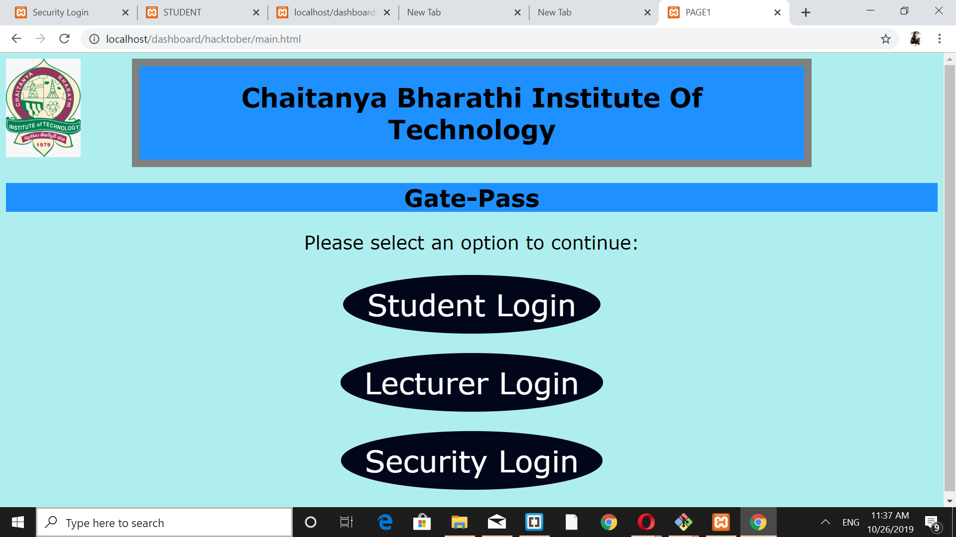
Working
The main page has three login options.(Student, Lecturer, Security officer.)
The user must choose one of those options in order to use the application.
The user is then required to Login using their Id and Password.
Then the sub pages appear…

Slide 9
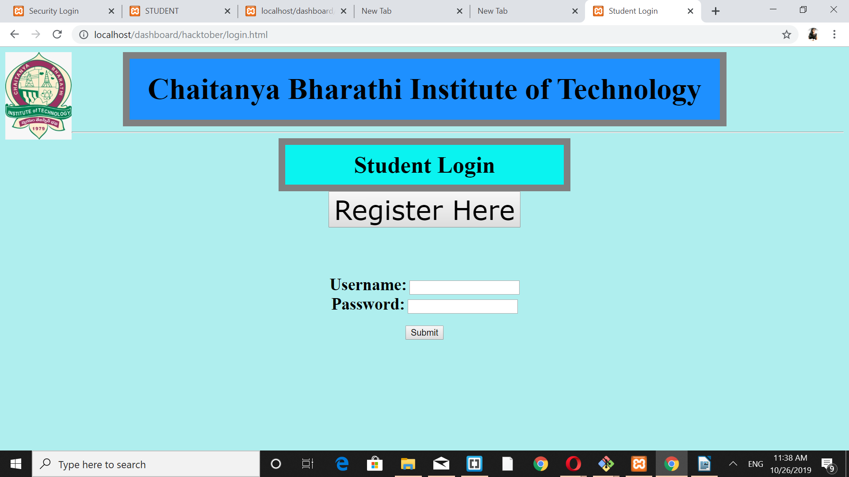
Student Page
The student has to fill in the details: Name, Roll Number, Time, and reason for permission
Then the user has to submit the request. It will be forwarded to the HOD of the respective department.

Slide 10
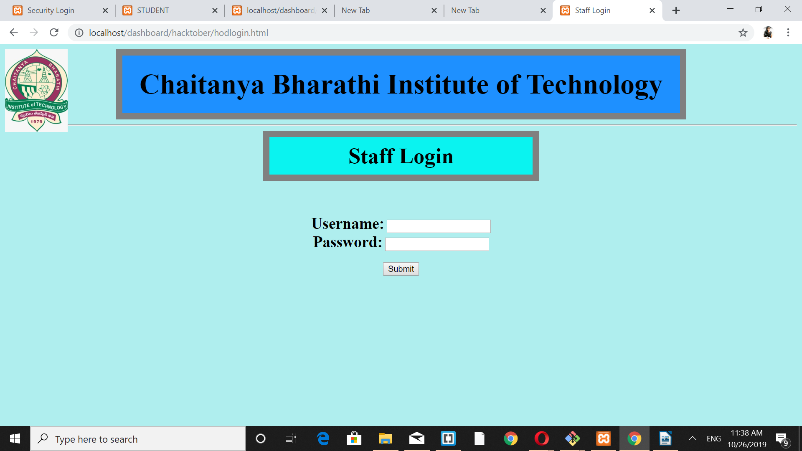
Staff(HOD) Page
The HOD receives the request.
Its up to the HOD to grant permission. If granted, the student is updated about it and the details are sent to the security guards.
The student has to use the notification that he/she receives as the gate-pass

Slide 11
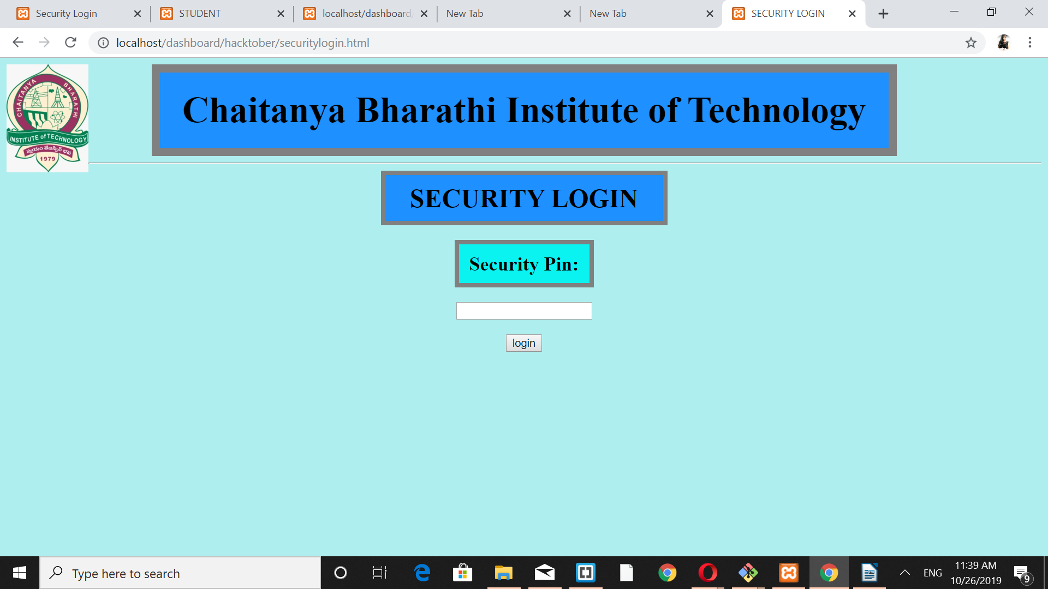
Security Officers’ Page
The details about the people who are granted permissions are uploaded in the website.
The security officers make use of those details to check if a student is given permission or not.

Slide 12
Conclusion
As this website enables easy request generation and promotes a hassle free experience for both student and the staff, it is a good companion to all the college-goers.

Slide 13
THANK YOU…

